Slide 1
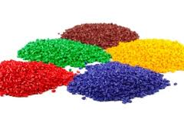
Normalization methods for analytical variance reduction
Goals: Evaluate batch effects in replicated measurements and overview normalization methods
Topics:
Batch effects
Sample normalization
Variable transformation
Variable normalization
Statistics

Slide 2
Identify the effects of sample drying
Use DATA: Normalization Data.csv
Visualize:
Batch effects in replicated measurements
The effect of normalization on samples and variables
Questions:
How can batch and outlier effects be mitigated?
Statistics

Slide 3
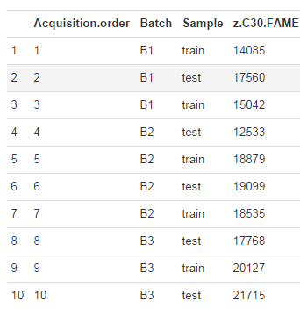
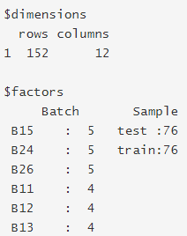
Question:
Are there any batch effects in this data?
Statistics

Slide 4
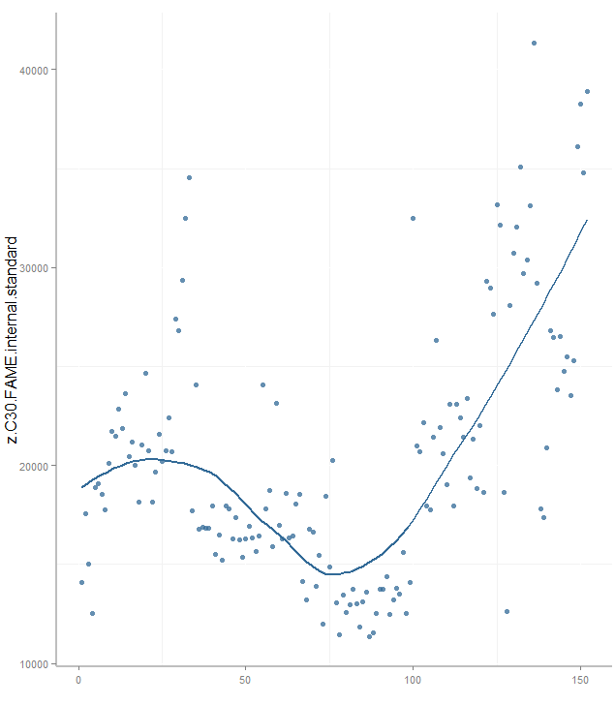
Answer:
Are there any batch effects in this data? (Yes!)
Statistics

Slide 5
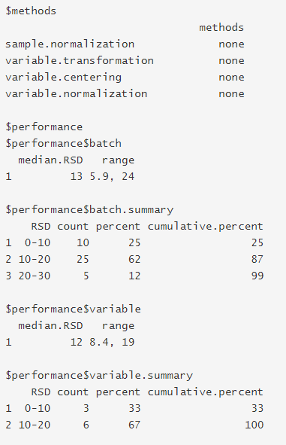
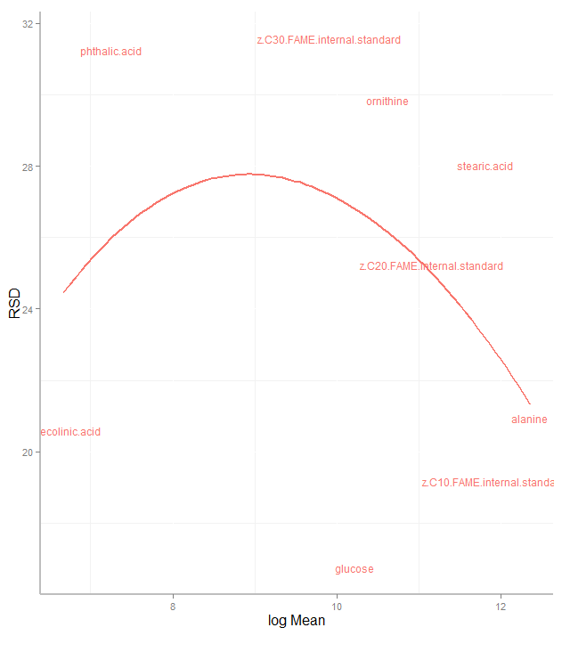
Answer:
Not all metabolites are similarly affected
Statistics

Slide 6
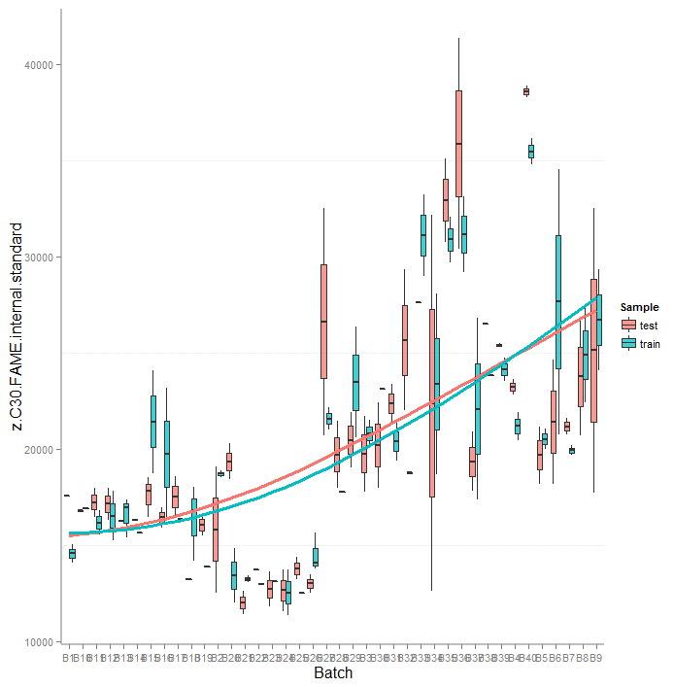
Question:
Can sample and variable normalizations reduce analytical variance and batch effects?
Statistics

Slide 7
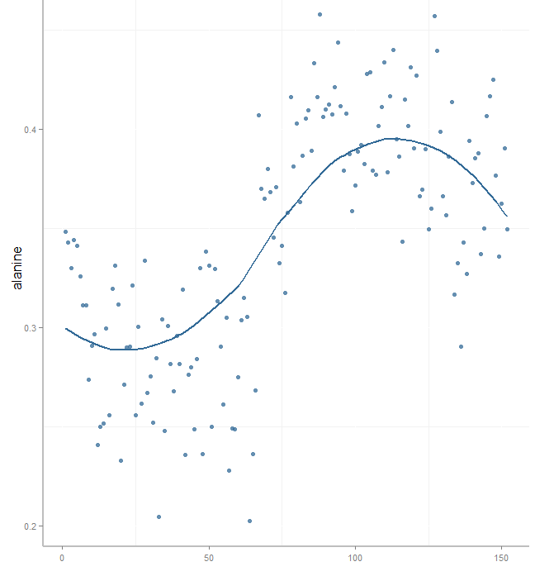
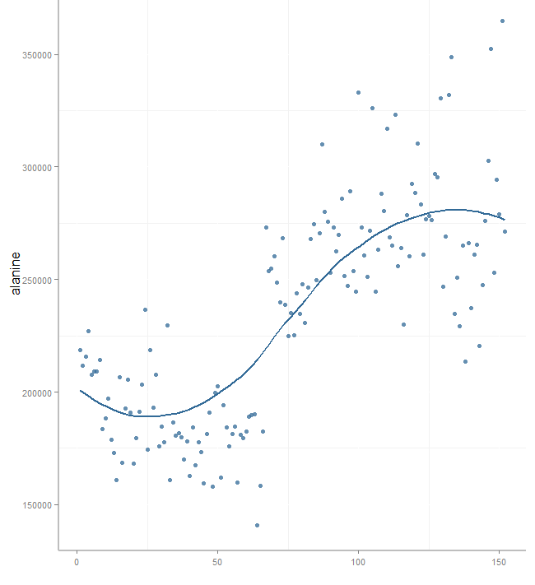
Answer:
Sample and variable normalizations can reduce or increase analytical variance and batch effects.
Sum normalization
raw
Statistics

Slide 8
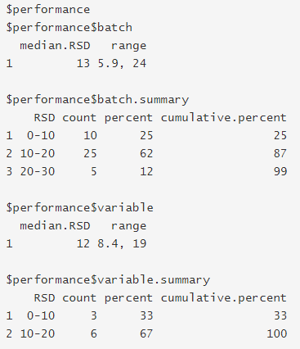
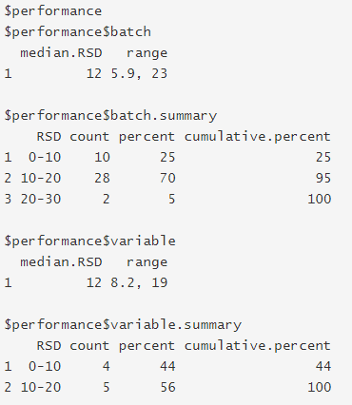
Answer:
Sample and variable normalizations can reduce analytical variance and batch effects.
raw
Sum normalization
Statistics

Slide 9
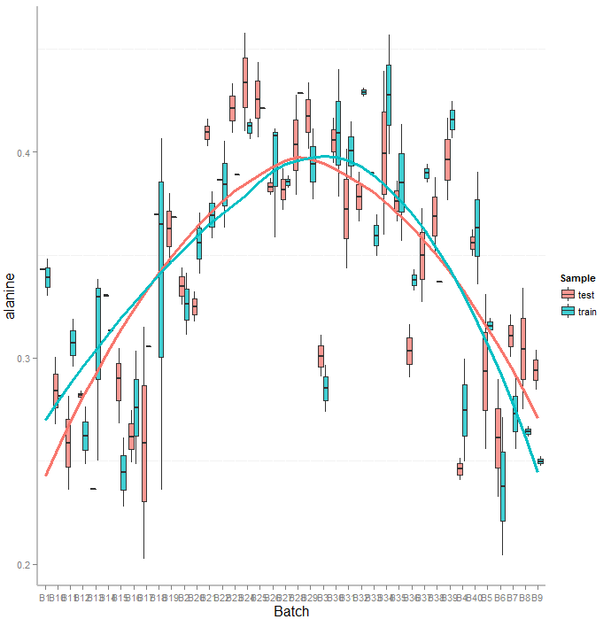
QC sample based normalizations
Can be useful for estimating and removing analytical variance
Statistics

Slide 10
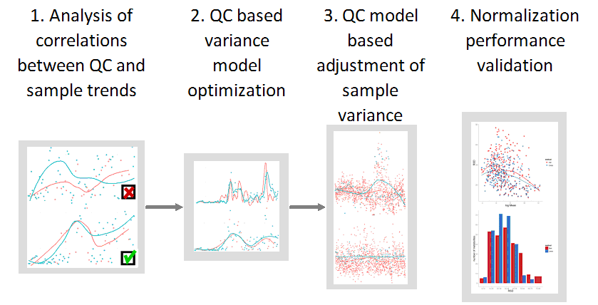
Example: qcLOESS workflow
Statistics

Slide 11
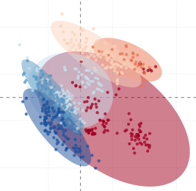
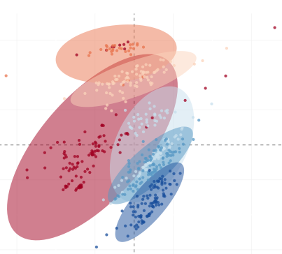
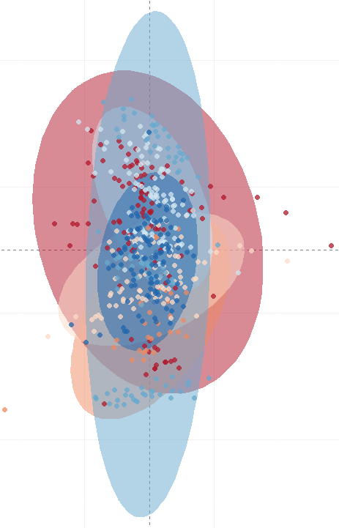
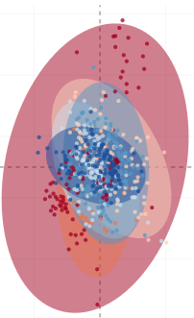
Overview of Normalizations (PCA)
Raw (%RSD = 13)
qcISTD (9)
Only LOESS included normalizations effectively remove analytical batch effects
qcISTD +
LOESS (8)
LOESS (12)
Notes:
11

